Slide 1







001
HOT ROLLED STEEL

Slide 2
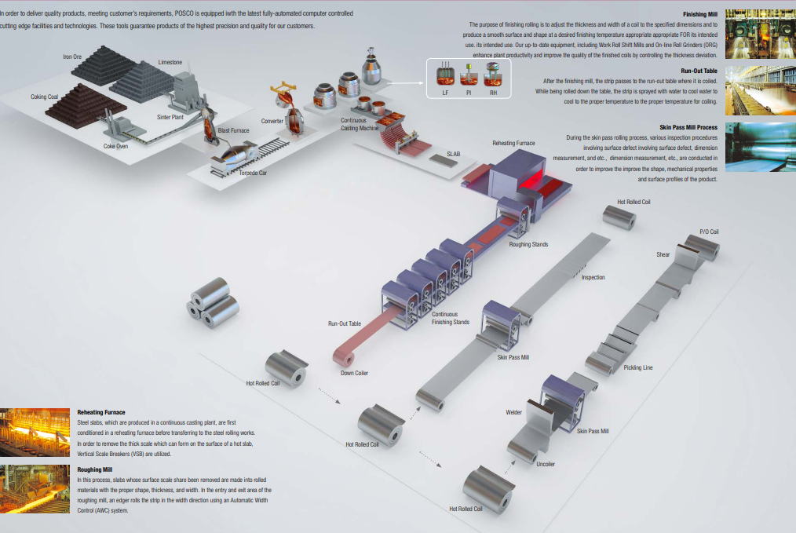
OVERVIEWMANUFACTURING PROCESS & EQUIPMENT
002

Slide 3
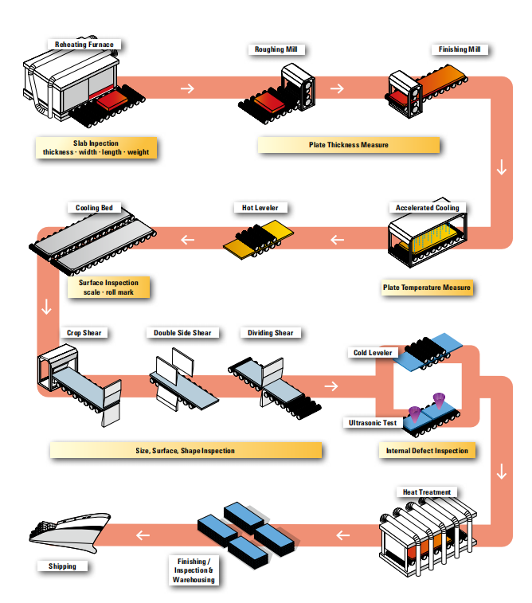
INSPECTION FLOW OF STEEL PLATE
003
POSCO has the automated quality assurance system. Automated monitoring and concurrent feedback using a computer-based information
system make POSCO best quality assurance company.

Slide 4
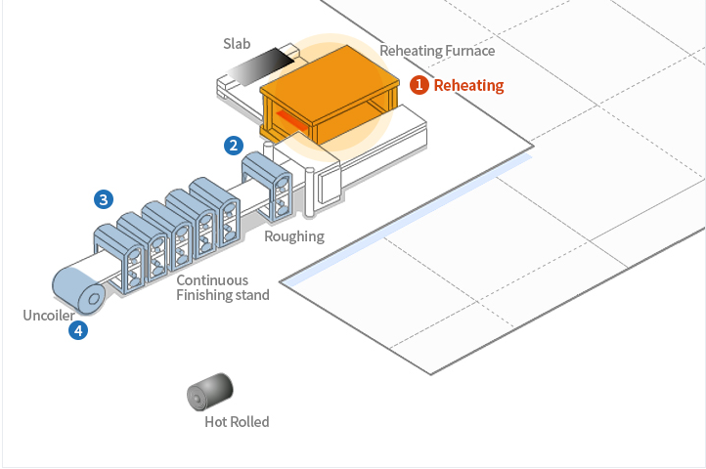
Reheating
004
Steel slabs, which are produced in a continuous casting plant, are first conditioned in a reheating furnace before being transferred to the steel rolling works. In order to remove the thick scale which can form on the surface of a hot slab, Scale Breakers (VSB) are used.

Slide 5
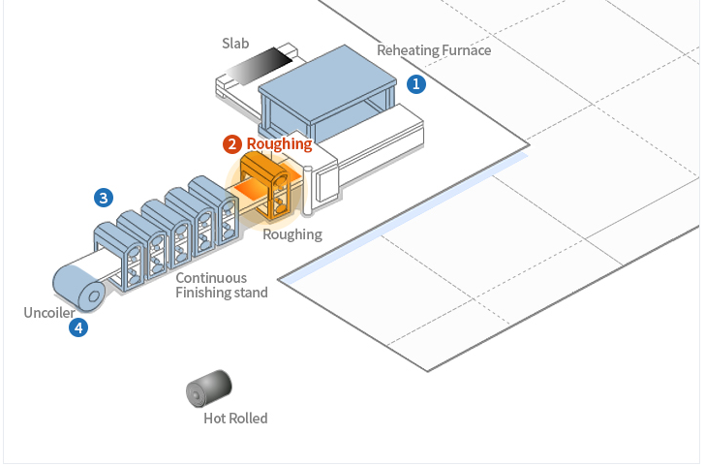
Roughing
005
In this process, slabs whose surface scale share has been removed are made into rolled materials with the proper shape, thickness, and width. In the entry and exit area of the roughing mill, an edger rolls the strip in the width direction using an Automatic Width Control (AWC) system.

Slide 6
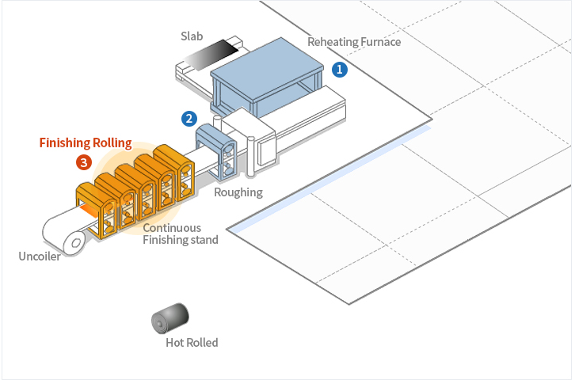
Finishing Rolling
006
The purpose of finishing rolling is to adjust the thickness and width of a coil to the specified dimensions and to produce a smooth surface and shape at the desired finishing temperature appropriate for its intended use. Our up-to-date equipment, including Work Roll Shift Mills, Pair Cross Mills and On-line Roll Grinders (ORG), enhances plant productivity and improves the quality of the finished coils by controlling the crown shape.

Slide 7
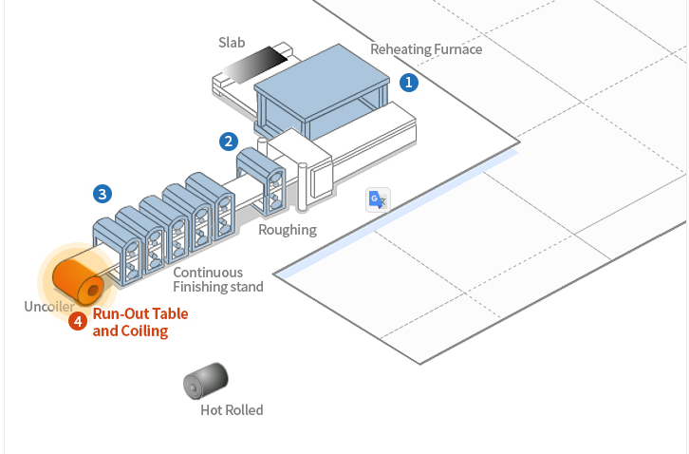
Run-out table and coiling
004
Steel strips, after the finishing mill, are passed to the run-out table where they are coiled. While being rolled on the table, the strips are sprayed with water to cool them to the proper temperature for coiling.

Slide 8
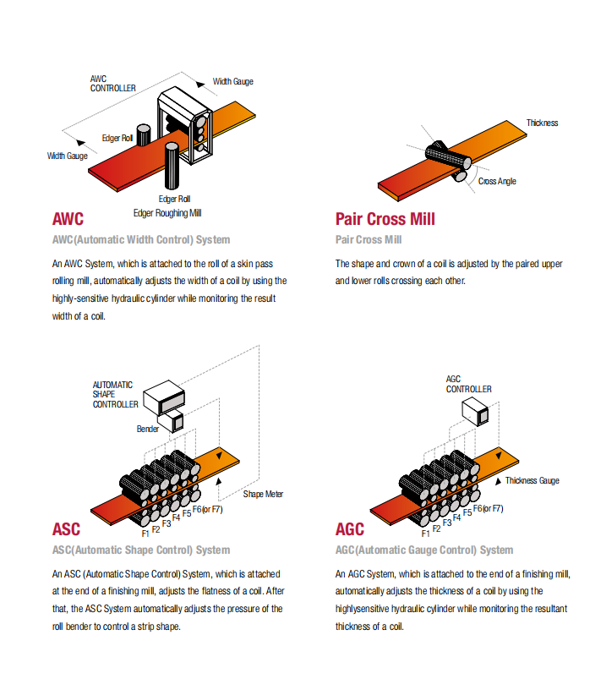
004
Some other machines

Slide 9
Thank
you!

